Slide 1
PIP4004 - INTERNSHIP
Review-1 Presentation
.Net Website Development Using VS Community
Student Details
Name | HUSNA BEGUM
Roll No | 20211CSE0030
Section | 8CSE-13
Batch No.
Under the Supervision of,
MS.RAKEEBA TASKEEN
Assistant Professor
School of Computer Science and Engineering
Presidency University
Name of the Program: CSE
Name of the HoD: Dr. ASIF MOHAMMED
Name of the Program Project Coordinator: MR.MD ZIAUR RAHMAN
Name of the School Internship/Project Coordinators: Mr. Md Ziaur Rahman /
Dr. Sampath A K / Dr. Abdul Khadar A

Slide 2
Content
Title
Abstract
Review of literature
Objectives
Problem identification, and formulation of problem statement.
Road map, impact and advantages of the proposed work. (Time Line by GanttChart).
References

Slide 3
Title
WEBSITE BUILDING USING .NET IN MVC

Slide 4
Abstract
.NET MVC is a modern framework for building web applications efficiently.
It follows the Model-View-Controller (MVC) architecture, which separates concerns for better maintainability.
Key benefits include:
  Scalability: Easily handles large applications.
  Security: Provides built-in authentication and authorization.
  Maintainability: Clear separation of logic improves code organization.

Slide 5
Review of Literature
Traditional monolithic web development faces challenges in scalability and maintenance.
MVC is widely adopted due to its structured approach and testability.
Studies highlight that .NET MVC offers better security features, performance optimization, and third-party integrations .
Case studies from Microsoft and other enterprises showcase successful implementation in large-scale projects.

Slide 6
Objectives
To understand the .NET MVC architecture and its core components.
To build a secure and scalable website using .NET MVC.
To implement efficient coding practices for better performance and maintainability .
To analyze the impact of MVC in modern web development.

Slide 7
Problem Identification and Formulation
Challenges in Traditional Web Development
  Lack of scalability in large applications.
  Security vulnerabilities in data handling.
  Complexity in managing code and UI updates.
Problem Statement
"How can .NET MVC be leveraged to build secure, scalable, and maintainable websites with enhanced performance?"

Slide 8
Roadmap and Proposed Work
Technology Stack
  Framework: .NET MVC
  Programming Language: Python , C
  Database: Firebase , MySQL
  Frontend: Bootstrap, HTML, CSS, JavaScript
  Tools: Visual Studio, Entity Framework, Visual Studio Community

Slide 9
Development Phases
  Requirement Gathering & System Design
  Frontend & UI Design
  Backend Development (Models, Controllers, Database)
  Testing & Debugging
  Deployment & Maintenance

Slide 10
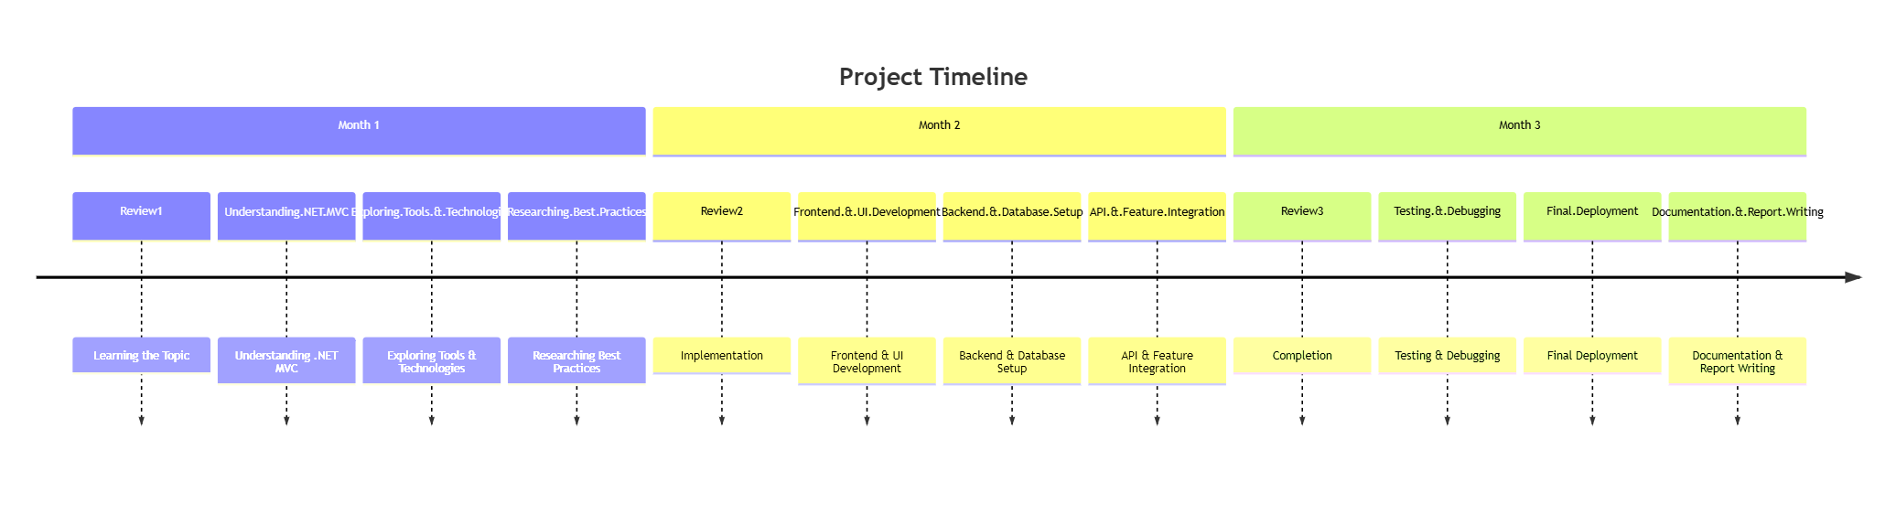
Timeline Gantt Chart

Slide 11
Impact and Advantages of Proposed Work
Impact
  Provides a structured development approach for future applications.
  Ensures better security and performance in web applications.
Advantages of Using .NET MVC
  Separation of concerns: Easier to maintain and scale.
  Built-in security: Protects against SQL injection & cross-site scripting (XSS).
  Faster development: Code reusability speeds up project completion.
  Integration with databases & third-party APIs.

Slide 12
References
Microsoft Documentation: https://learn.microsoft.com/en-us/aspnet/mvc/overview/
.NET Official Site: https://dotnet.microsoft.com/
Research Paper on MVC Frameworks in Web Development

Slide 13

Q&A

Slide 14
Thank you !!

